Slide 1

Battery Management System

Slide 2
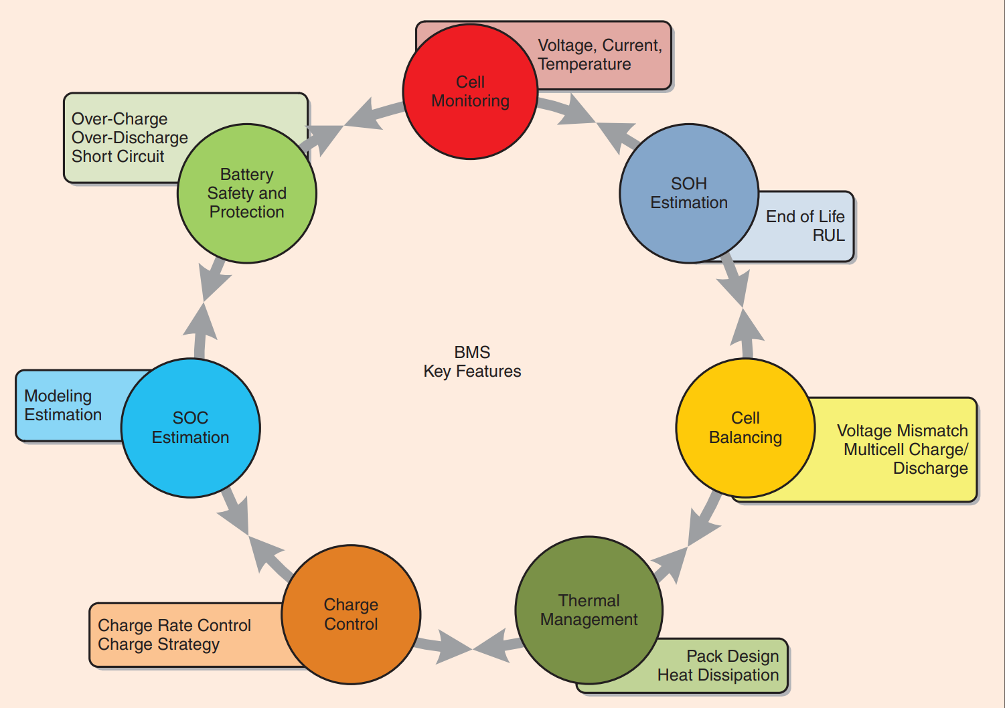
Overview
Rahimieichi, H. , et al. "Battery Management System: An Overview of Its Application in the Smart Grid and Electric Vehicles." Electrets 2013.
Notes:
Ensure safety.
Monitoring the condition of the battery.
Prolong the life of the battery.

Slide 3
Important part: State Estimation
Problem: Battery Degradation
Estimate the state of charge (SOC), state of health (SOH), remaining useful life (RUL).
Prevent unpredictable failure.
Need a precise battery model.
Need a comprehensive definition of state of health.

Slide 4
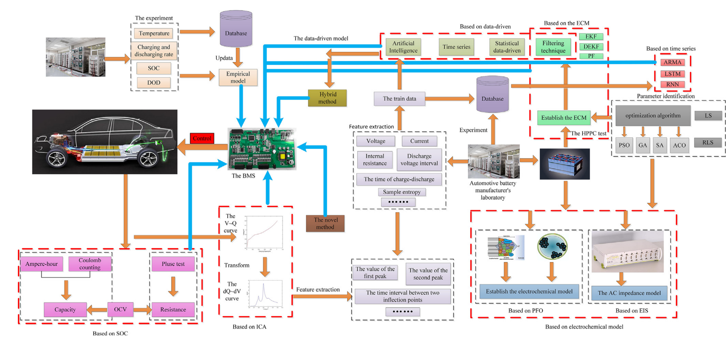
State Estimation Methods
Xuebing, et al. "A review on the key issues of the lithium ion battery degradation among the whole life cycle - ScienceDirect." eTransportation 1:100005-100005.

Slide 5
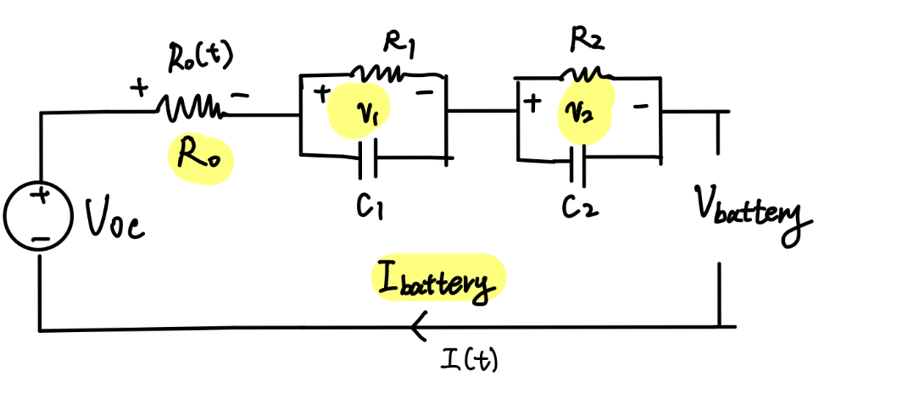
Equivalent Circuit Model
R-2RC Model
R0 stands for resistance of contacts, electrodes, and electrolytes.
RCs simulate the dynamic features during charge and discharge.
$$V\left(t\right){=V}_{oc}−I\left(t\right)R_{0}−I\left(t\right)R_{1}\left({1−e}^{−\frac{t}{C_{1}R_{1}}}\right)−I\left(t\right)R_{2}\left({1−e}^{−\frac{t}{C_{2}R_{2}}}\right)$$

Slide 6
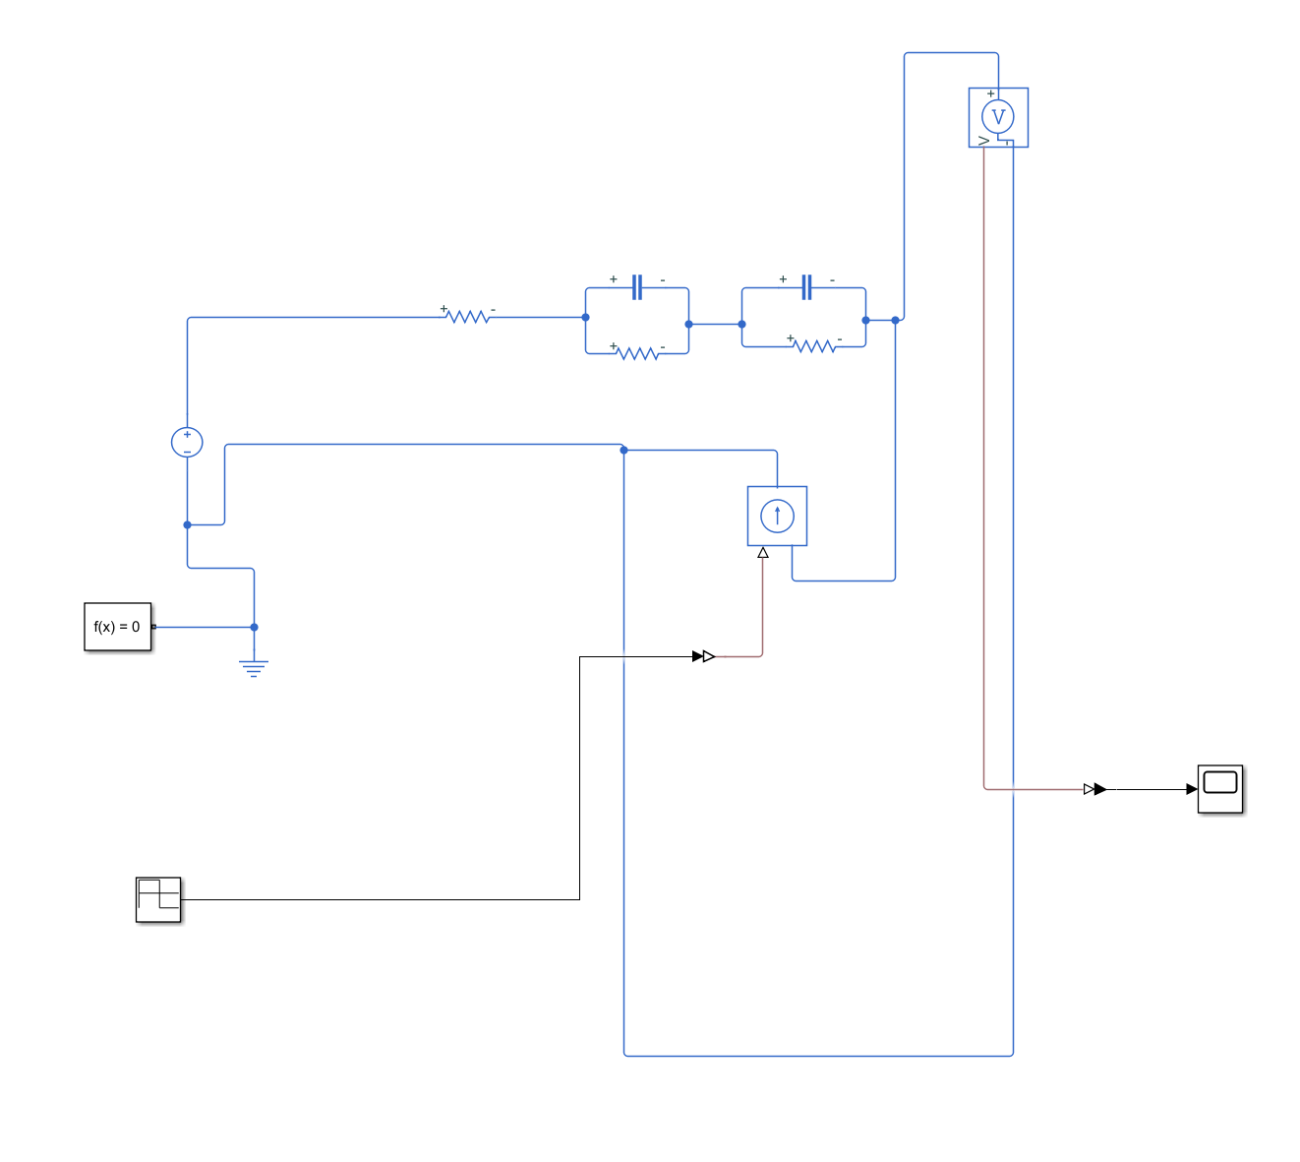
Simulink: Naive Version
I (t) > 0 : Discharge
I (t) < 0 : Charge
Nominal charge
Look-up table based on SOC & temperature

Slide 7
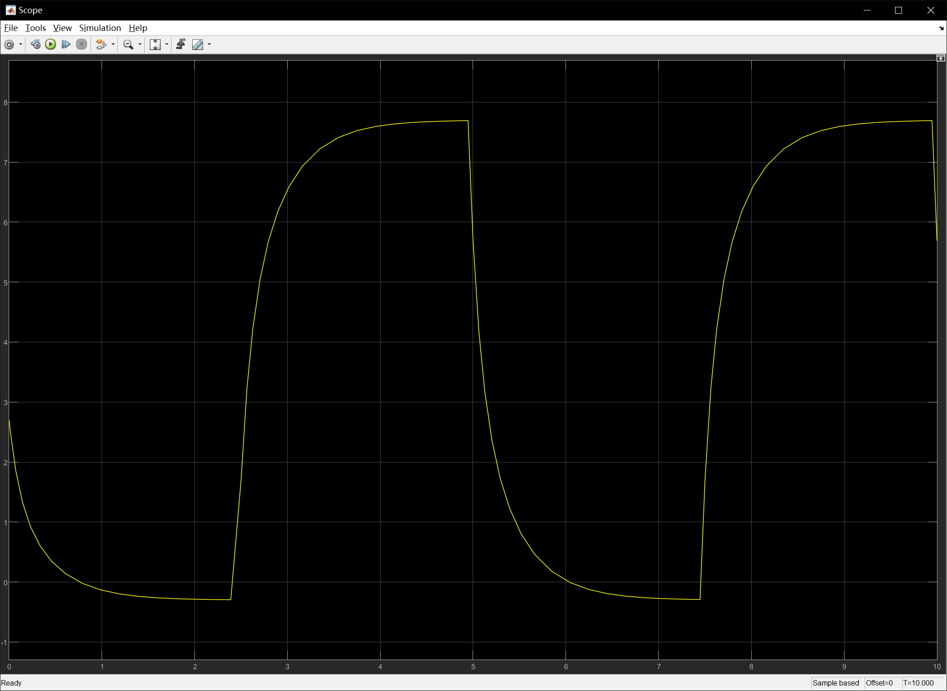
Simulink: Result

Slide 8
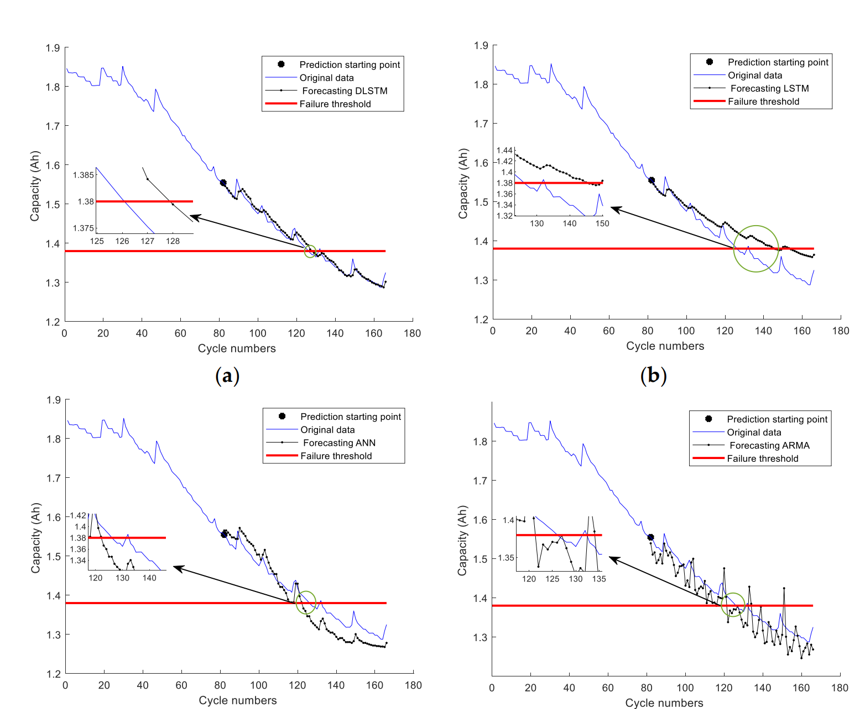
Data-driven methods
Mainly based on machine learning approaches.
Recent work mainly focused on CNNs or LSTMs.
Achieving really high accuracy in few steps ahead prediction.
Wang, C. , et al. "Dynamic Long Short-Term Memory Neural-Network- Based Indirect Remaining-Useful-Life Prognosis for Satellite Lithium-Ion Battery." Applied Sciences 8.11(2018):2078.
Notes:
[1] Ardeshiri, R. R. , et al. "Machine Learning Approaches in Battery Management Systems: State of the Art: Remaining useful life and fault detection." 2020 2nd IEEE International Conference on Industrial Electronics for Sustainable Energy Systems (IESES) IEEE, 2020.

Slide 9
Challenges
Model-based
Different methods focus on different features of the battery.
Too simple => Not able to capture the feature.
Too complicate => Overfitting.
Hysteresis effect.
Data-driven
High cost to get run-to-failure data.
Real environment will introduce noise.
Need more accurate long-term prediction.
High computation cost for online implementation.

Slide 10

Thank you!

